Slide 1
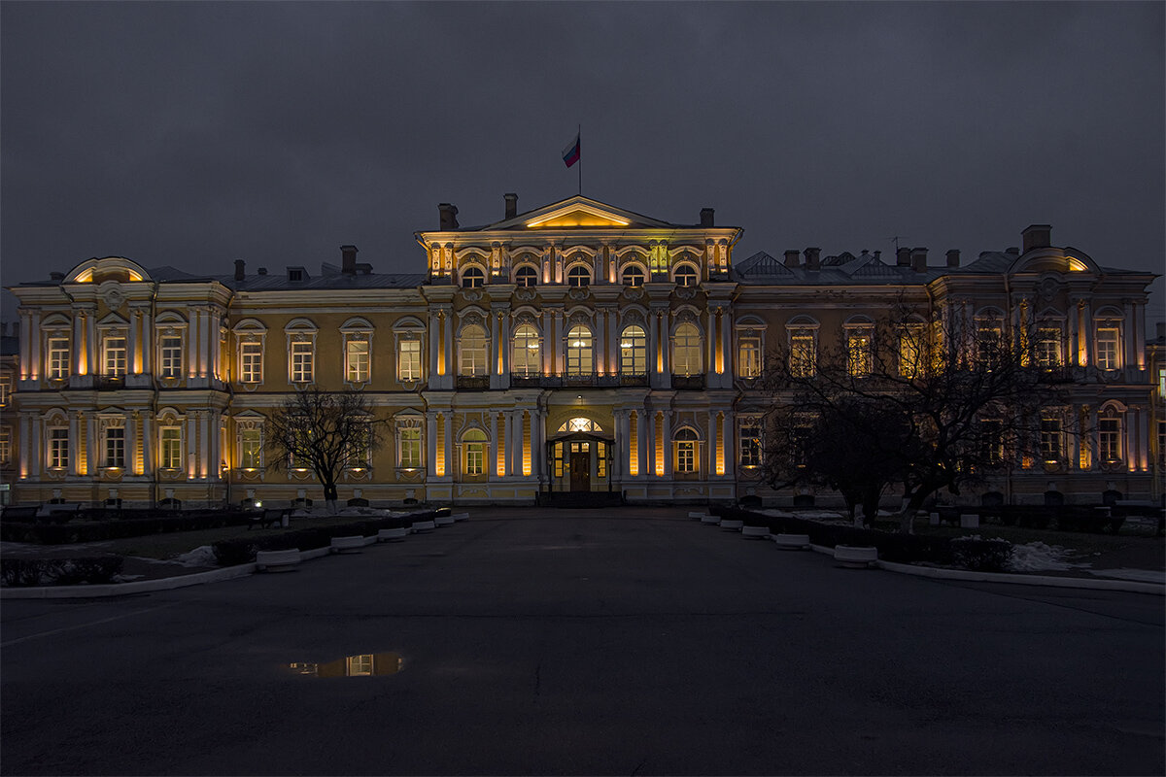
The Vorontsov Palace
Completed by a student 2-1/4 groups: Mikhailovskaya Kristina

Slide 2

Short description
It was erected by architect B. F. Rastrelli in 1749-1757 for Count M. I. Vorontsov. The palace is distinguished by a rich, elegant decoration of facades and lush interior decoration. There are more than 50 ceremonial halls and rooms in the palace. The palace is decorated with stucco, gilded carvings and other elements accompanying the Baroque style.
Address: Sadovaya street 26

Slide 3
History
In 1763, the palace was seized by the state due to huge debts. Emperor Paul I ordered to rename the building to the "Castle of the Knights of Malta" and give it to the Freemasons. A white cross, the symbol of the order, was erected over the gates of the former Vorontsov Palace.In the time of Alexander I, the Vorontsov estate again became the property of the state. The palace was handed over to the Page Corps. Guards were trained in this educational institution. A dormitory for cadets was organized on the second floor of the building.After the socialist Revolution, the Page Corps was liquidated, and the Vorontsov Palace was transferred to the management of Leningrad museums. In 1958, the St. Petersburg Suvorov School was located in the house, which is located here to this day.In 2003, the Maltese Chapel at the Vorontsov Palace was completely restored. It hosts excursions and concerts of Catholic music. In addition, the chapel has a museum of the history of Russian cadets.

Slide 4
Interesting facts
The construction of the palace required such expenses from Count Vorontsov that he had no money left for the maintenance of this building, and in 1763 he had to give it to the state treasury to cover the costs incurred and repay the debts.Unfortunately, the inner luxury of the palace has not survived to this day, so even in the photo of the palace we will not be able to see what the rooms inside looked like.

Slide 5
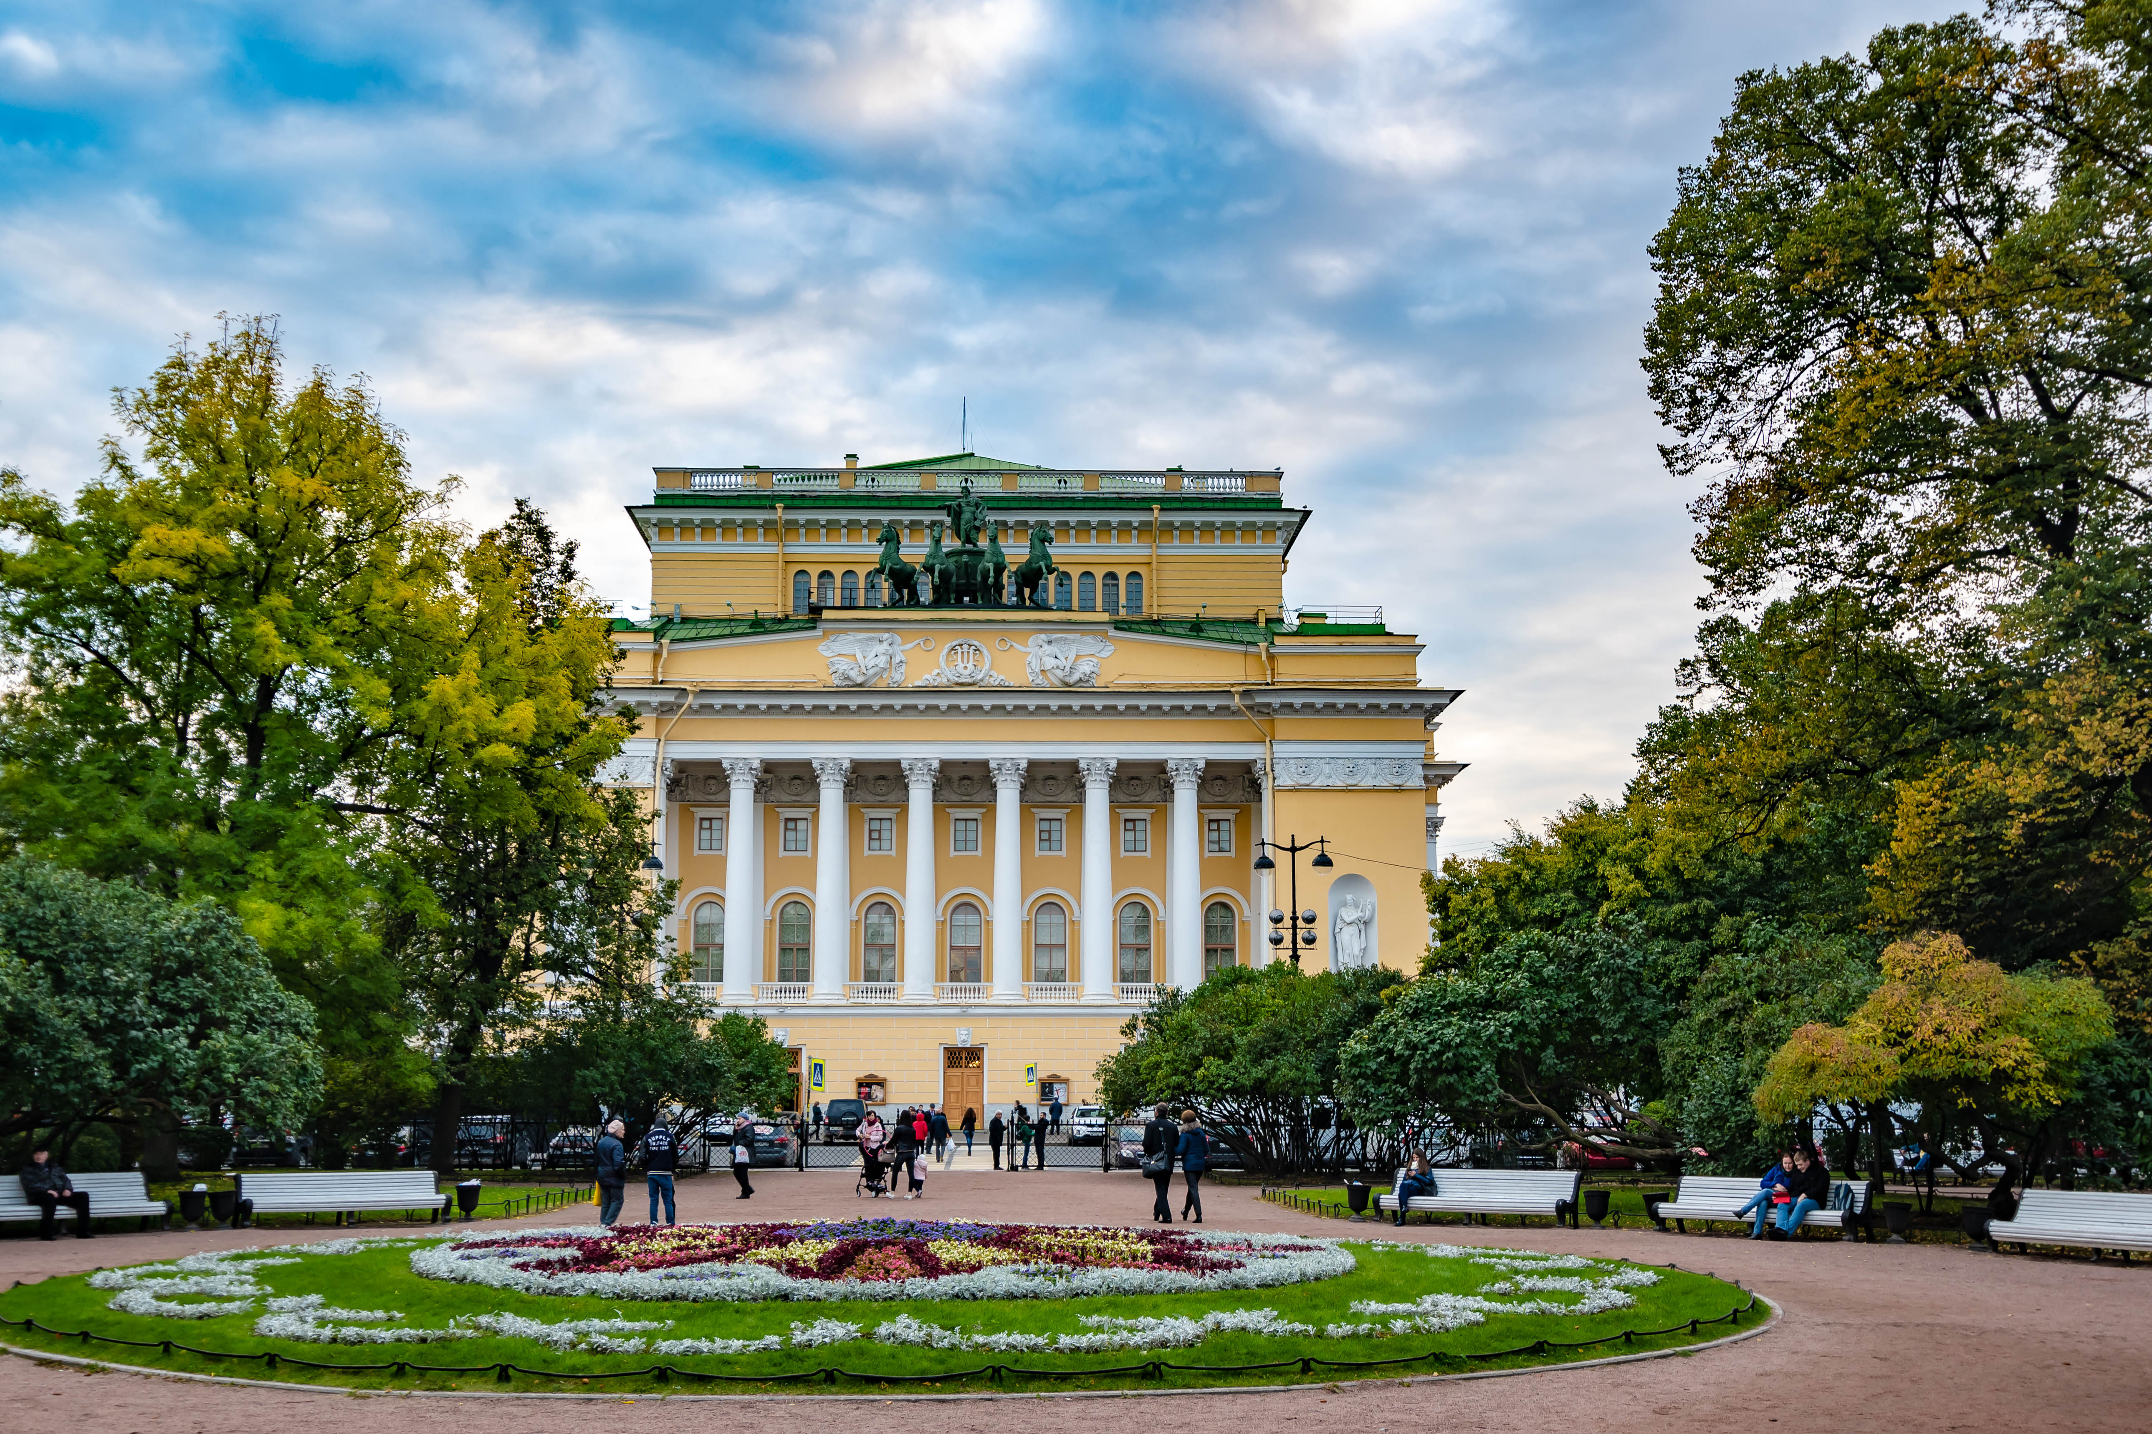
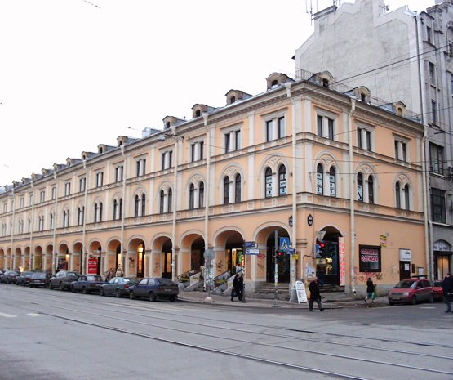
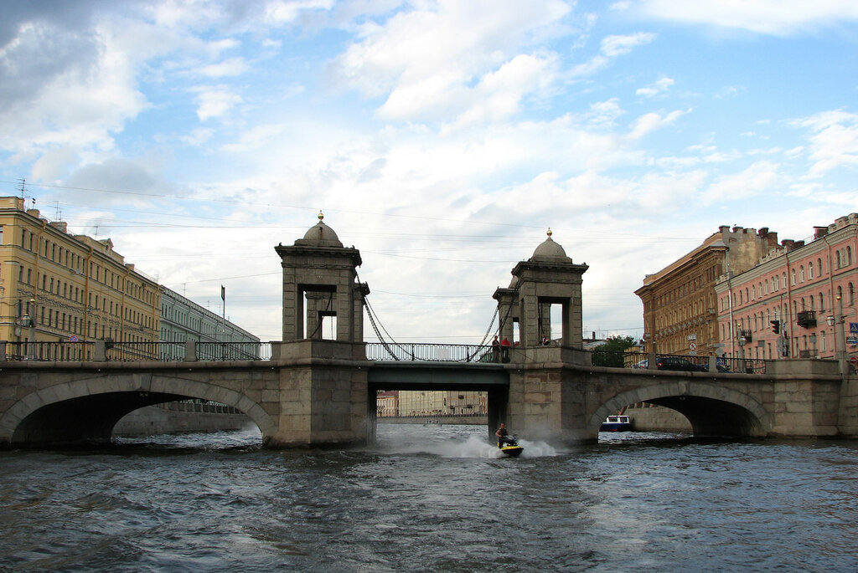
Other sights around
Nearby is:
Alexandrinsky Theater
Apraksin Yard
Lomonosov Bridge

Slide 6
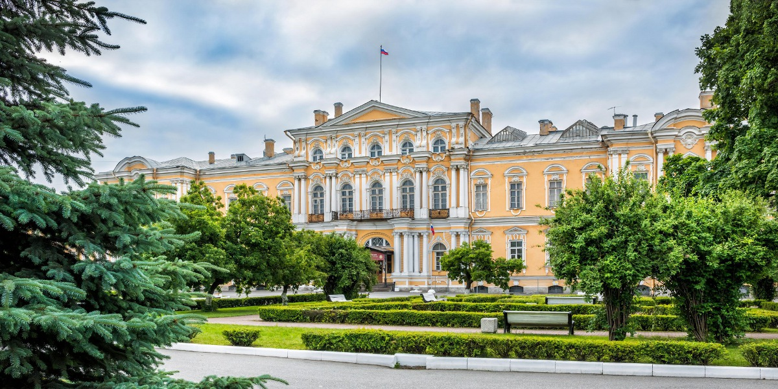
My visit.
Every time I go to the center, I definitely pass and admire this building!

Slide 7
Questions.
1. In what style is the palace made?
In the Baroque
2. Which school was located in 1958 in the palace?
the Suvorov school

Slide 8
Thanks for attentia’s

